Slide 1
Housing Price Prediction
Submitted by :- Ruchi Tiwari

Slide 2
Data Preparation
With the help of Pandas Library We will upload our data to Jupyter Notebook.
Once our data is uploaded with the help of predefined method (i.e. read_csv) we can read data for further processing.
We have two type of variables in the data:-
Dependent Variable
Independent Variable

Slide 3
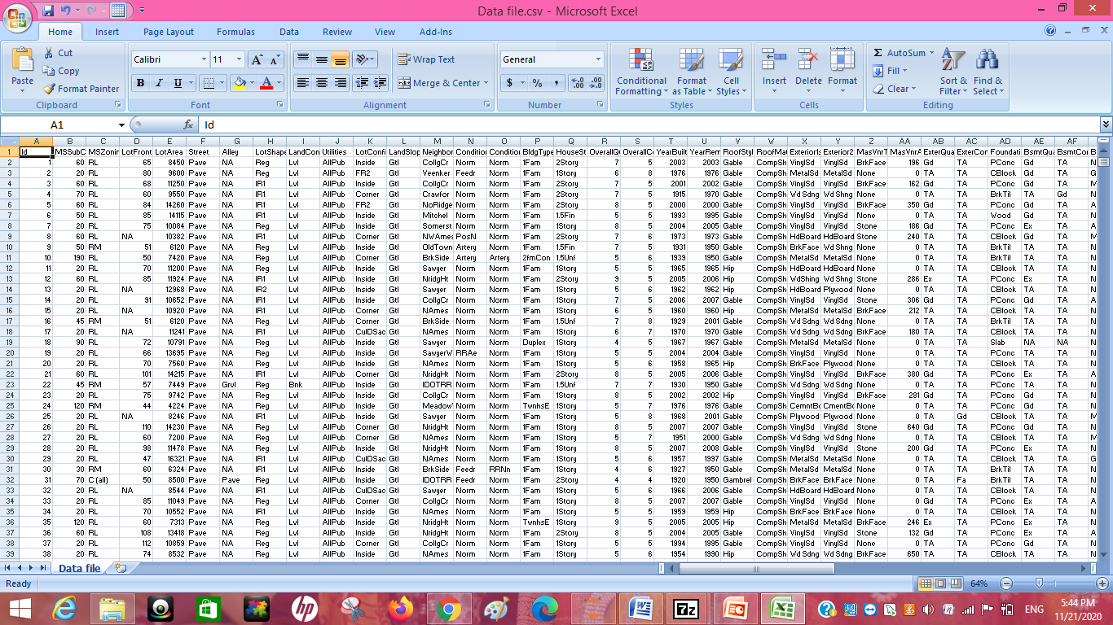
Input Data
Data file in CSV format

Slide 4
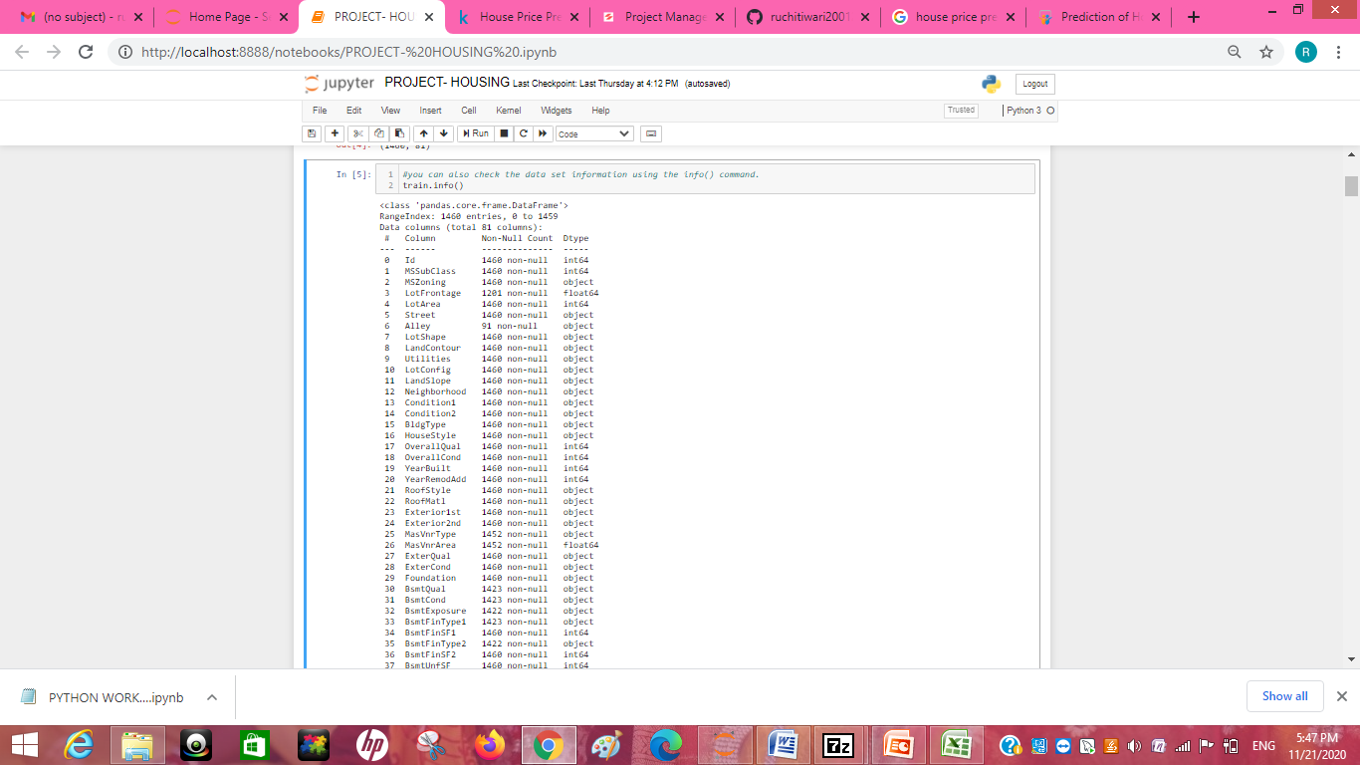
About Data
With the help of info I get to know about the data type of each columns
There are 3 column which is having float as data type, 35 Column holds Integer Value(INT) and 43 columns are of Object Type.

Slide 5
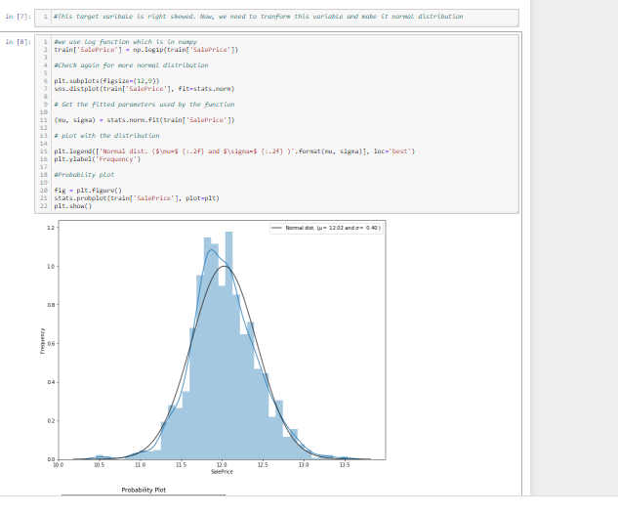
When I plot the data I see that It was right skewed than I make it normal distributed.

Slide 6
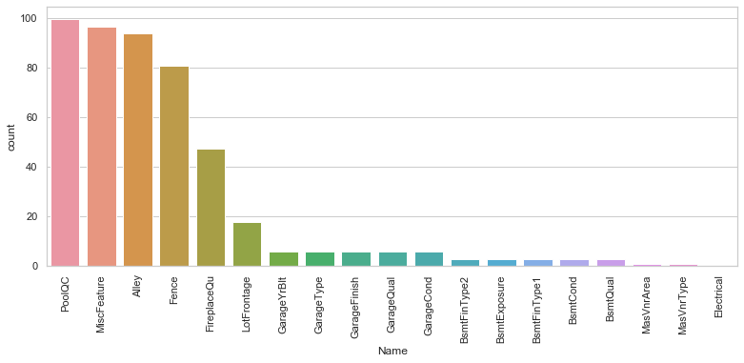
Missing Values
The Highest number of missing values are in PoolQC .

Slide 7
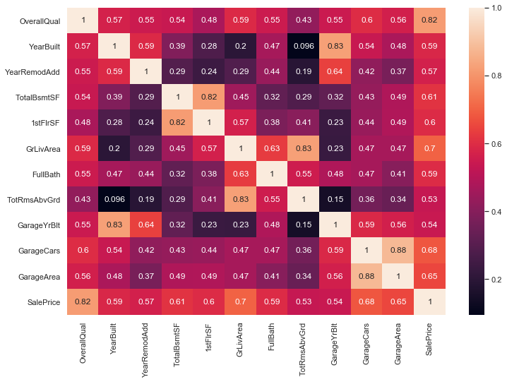
OverallQual is highly correlated with target feature of saleprice by 82%

Slide 8
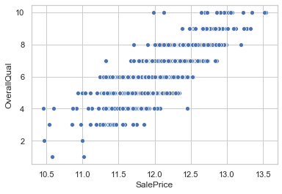
The higher the overall quality of the house, most often, the higher the sale price of the house. The two points furthest to the left for OverallQual of 10 it may be an outlier.

Slide 9
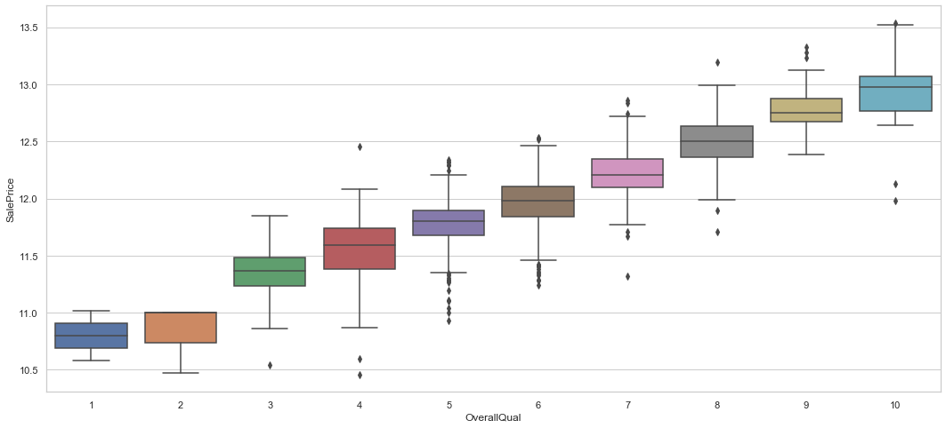
A boxplot is a standardized way of displaying the dataset based on a five-number summary: the minimum, the maximum, the sample median, and the first and third quartiles.

Slide 10
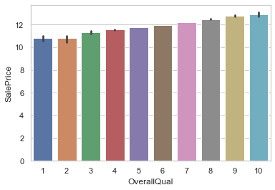
Unique value of OverallQual with Saleprice

Slide 11
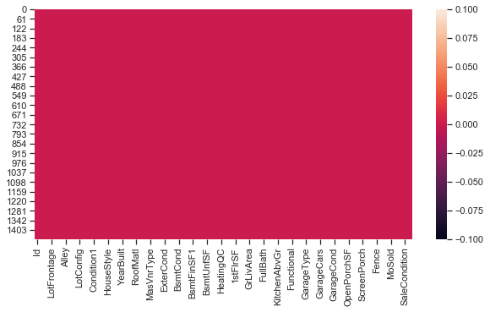
From the Graph it show now that there is no null value present in the dataset.

Slide 12
DATA PREPROCESSING
The Complete data is divided in the ration of 80:20 for train and test respectively.
Since no need of Utilities column for the current processing it was not used so I drop it.
There is so many null value in the dataset which got filled by none,zero and mode there are some outliers present in the dataset which has been removed with the help of predefine methods.

Slide 13
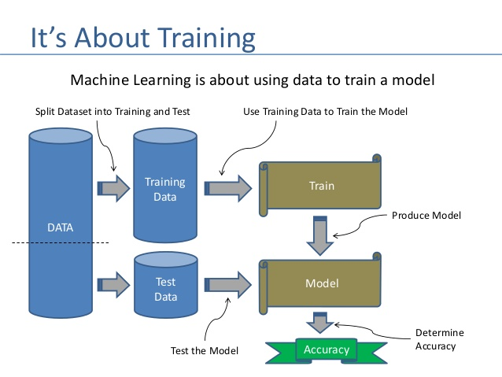

Slide 14
Result
Following are the result :-
Linear Regression Accuracy - 89.26708677161673
RandomForestRegressor Accuracy - 89.50756697054788
GradientBoostingRegressor Accuracy 91.7617954655
Lasso - 0.8575316934169622
Ridge -0.8823303048464654
ElasticNet :-0.7818976860065255

Slide 15
Conclusion
I check the data first and uploaded the data in jupyter notebook and than I visualize the features ,Perform the preprocessing in the data and understand the relationship between different features.
I used both train-validation split and the cross validation to evaluate the model effectiveness to predict the target values.
At the end I applied the four predictive models in the data.
I started with,LinearRegression, GradientBoostingRegressor
,RandomForestRegressor, Lasso , Ridge and ElasticNet and based on the best result I saved to model GradientBoostingRegressor.

